Slide 1




Sprint Review #1
Group 4
06.01.2023
PROJECT MANAGEMENT
SYSTEM

Slide 2
OVERVIEW
Summary
Demo
Sprint Goal | Objective
Project Contextualization | Work Methodology
Domain Model
User Stories | Class Diagram & Sequence Diagram

Slide 3

Requirements Engineering
Glossary
OO Analysis
Implementation
OO Design
Supplementary Specification – FURPS+
Use-Case (UC) Text
User Stories (US)
System Sequence Diagram (SSD)
Use-Case Diagram (UCD)
Domain model
Conceptual classes
Attributes
Associations
Class Diagram
Code
Tests
Sequence Diagrams
SPRINT GOAL

Slide 4

Requirements engineering | OO Analysis OO Design | Implementation
PROJECT CONTEXTUALIZATION
An IT company needs to develop a project management system for software development process (SDP).
The company uses scrum for project management.
WORK METHODOLOGY
Small groups US/pair Pair programming
Notes:
Rotação pares fase design --> implementação
Rotação US fase design --> implementação

Slide 5
DOMAIN MODEL

Slide 6
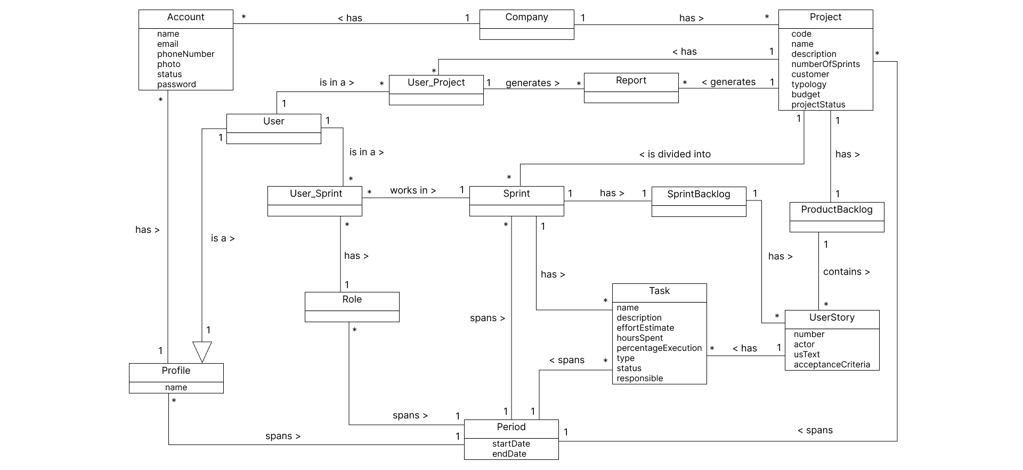
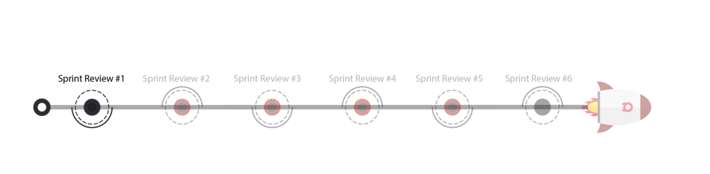

Slide 7
CLASS DIAGRAM

Slide 8
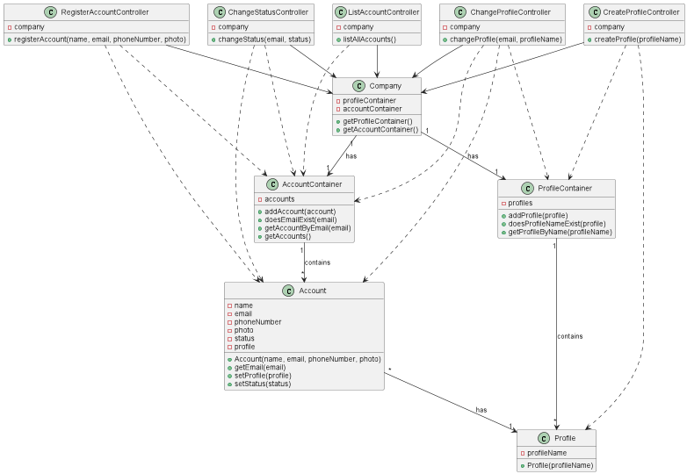

Slide 9
SEQUENCE DIAGRAM

Slide 10
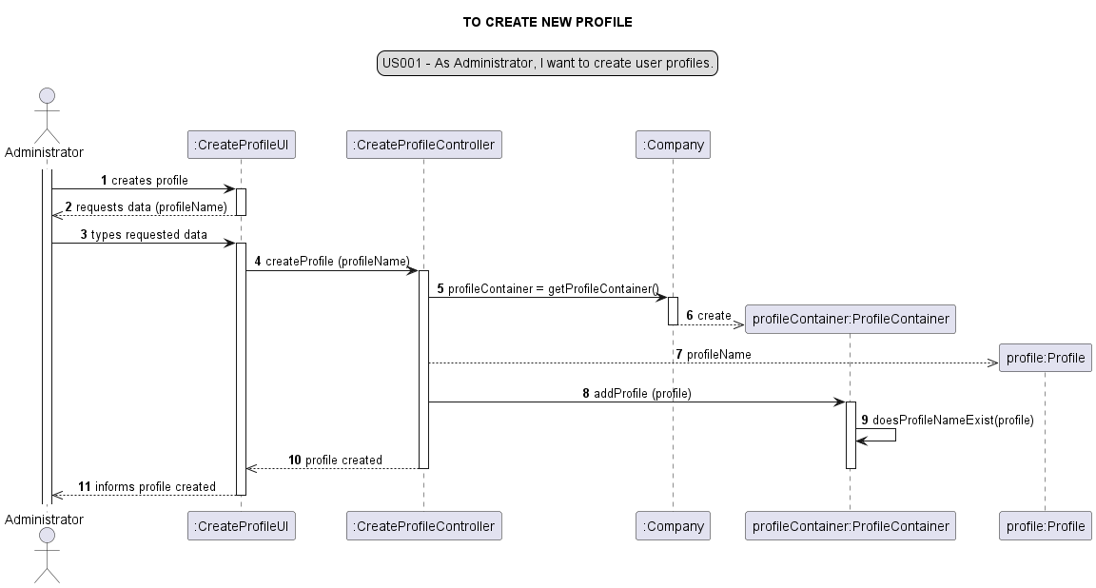
US001

Slide 11
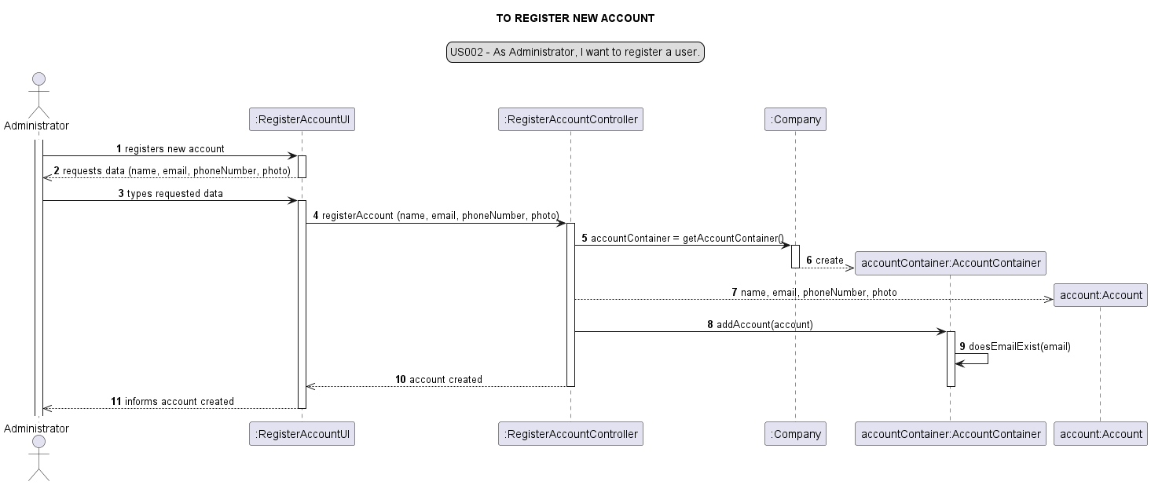
US002

Slide 12
US003

Slide 13
US004

Slide 14
US005

Slide 15
US006

Slide 16
DEMO

Slide 17
SUMMARY
Too many arguments in Account constructor → Builder pattern
High coupling between layers → DTO
Accumulation of responsibilities → Service layer
Notes:
Objectivo Builder pattern:
Reduzir o número de argumentos necessários para criar uma account através de criação de um método builder que contém vários métodos set
Objectivo DTO:
Low coupling- reduzir o chamamento de métodos
High cohesion – métodos devem contribuir para uma responsabilidade
Service layer
Controller não possui actualmente regras de negócio apenas tem o fluxo da informação.

Slide 18

Ana Sofia Oliveira - 1221862
Bárbara Oliveira - 1221820
Caroline Silva - 1221823
Cristiana Moreira - 1221826
João Pedro de Magalhães - 1221840
João Pedro Serra - 1221842
Jussara Oliveira - 1221845
Margarida Ferreira - 1221847
Mariana dos Santos – 1221848
Rui Pedro Pinho - 1221860

